Slide 1

Sustainable Supply Chain Management
Introduction to sustainability
Lesson 9

Slide 2

Presentation Outline
Background to Sustainable Supply Chain Management
Sustainability Development Goals vs Sustainable Supply Chain Management
Reverse Logistics and Other Preceding Terms
Green Supply Chain Management
Sustainable Supply Chain Management
World's First Electric Road: Charging EVs While Driving (youtube.com)

Slide 3
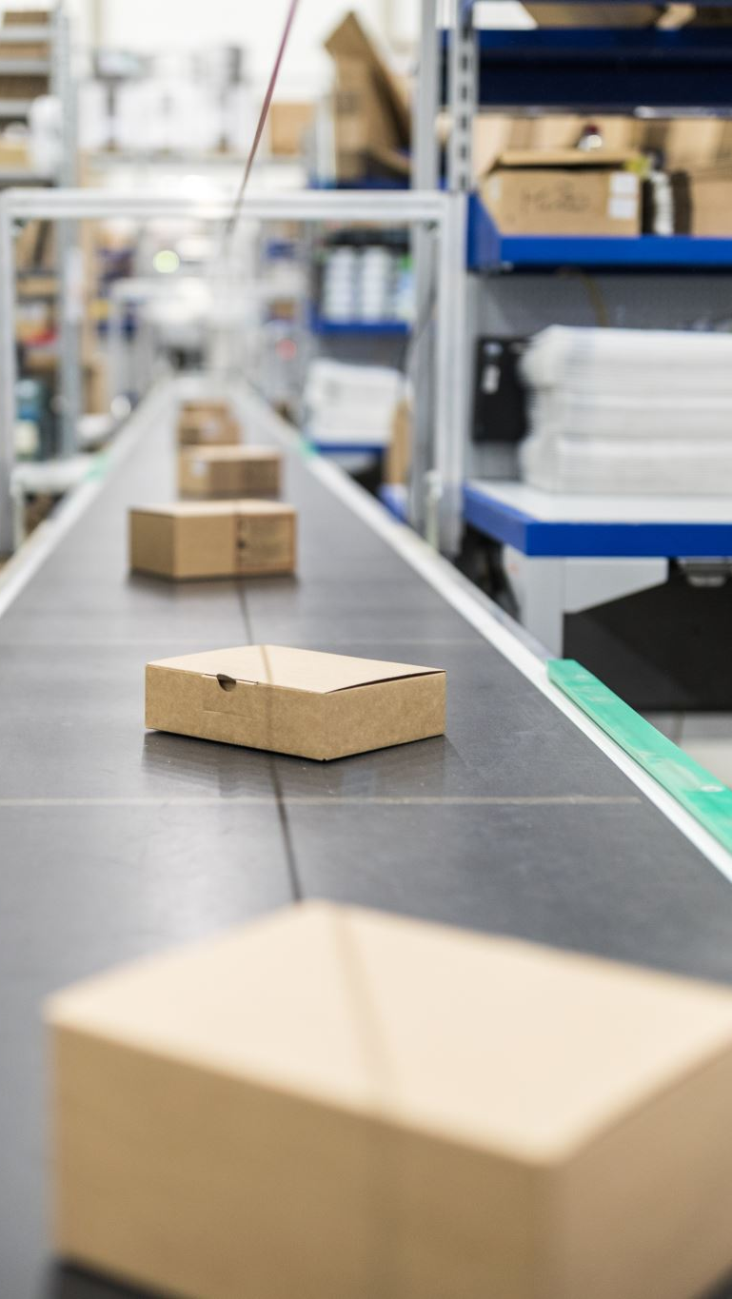
Background of Sustainable Supply Chain Management
Supply chain management (SCM) is the management of products or services from the design phase to the different production stages starting with raw material extraction and ending with the delivery of the product/service to the end consumer
This includes the management of material, information, and capital flows as well as the management of human resources (HR) to deliver the product/service to the consumers at a low cost, quickly and at the right place, while still ensuring the quality of the product/service.

Slide 4

Background of Sustainable Supply Chain Management - Contd
Sustainable supply chain management (SSCM) is the management of supply chains (SC) in a way that integrates the sustainability objectives and requirements defined by the firm, suppliers, customers, and external stakeholders
These sustainable objectives include economic, social, environmental and ethical target where all the members of the supply chain must reach
Consequently, confusion is common between terms such as green supply chain management (GSCM) and sustainable supply chain management (SSCM)
GSCM will be used to refer only to environmental performance of SC, while SSCM will be used to refer to the economic, environmental, and social performance of SC.

Slide 5
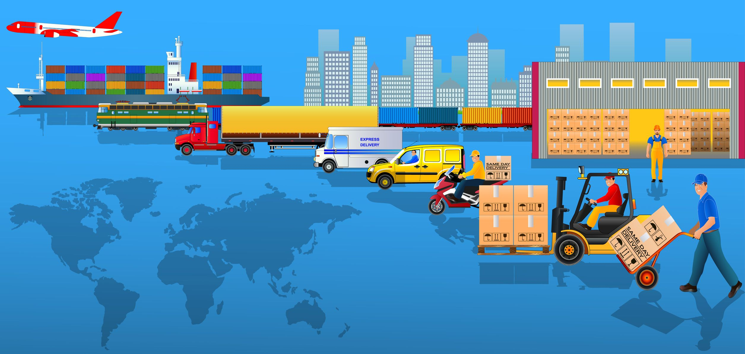
Sustainable Supply Chain Management vs Sustainability Development Goals
It is argued here that integrating the three pillars of sustainability into SCM to make sustainable in alignment with the 12th Sustainable Development Goal (SDG) is not enough today as complexity grew among global SCs, and according to the 17th SDG, there is also a necessity to engage more with stakeholders into the development of sustainable SCs
There is a need to analyze SCs in a holistic manner that includes not only the individual companies forming a SC but also SCs direct and indirect stakeholders such as the media, the general public, governmental bodies, research, and education organizations

Slide 6
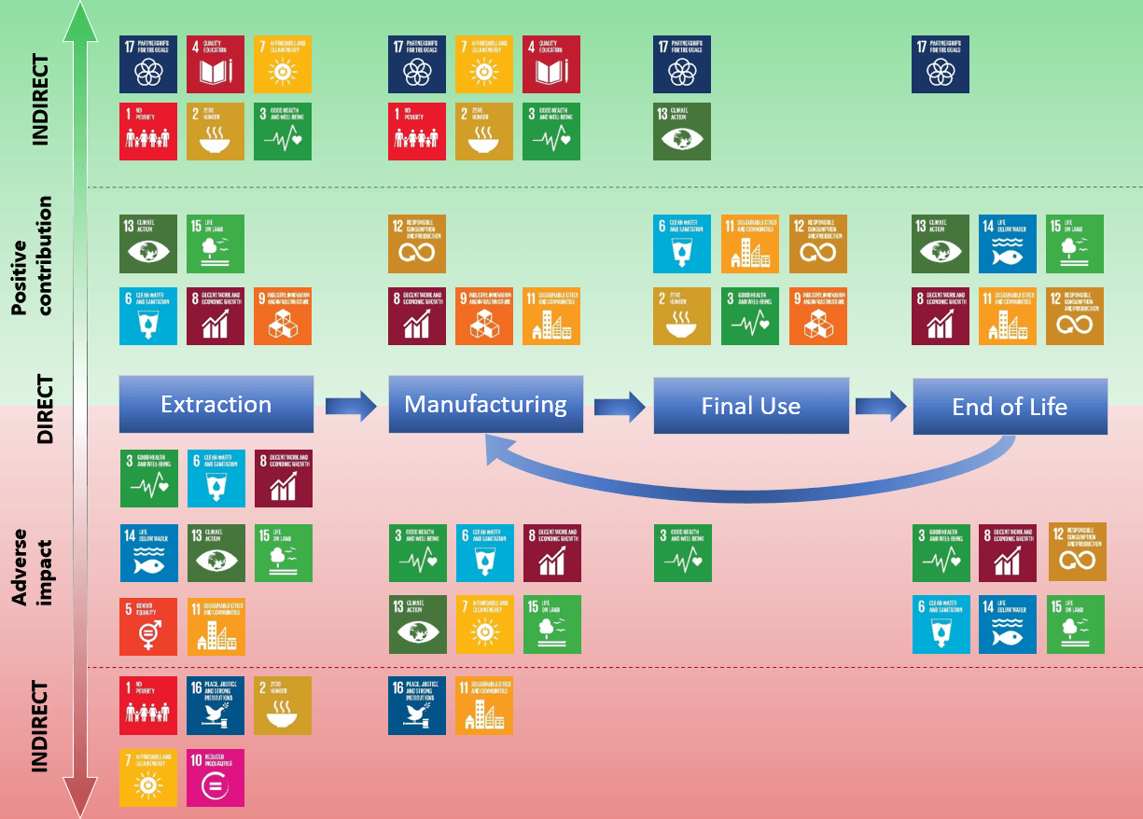

Slide 7
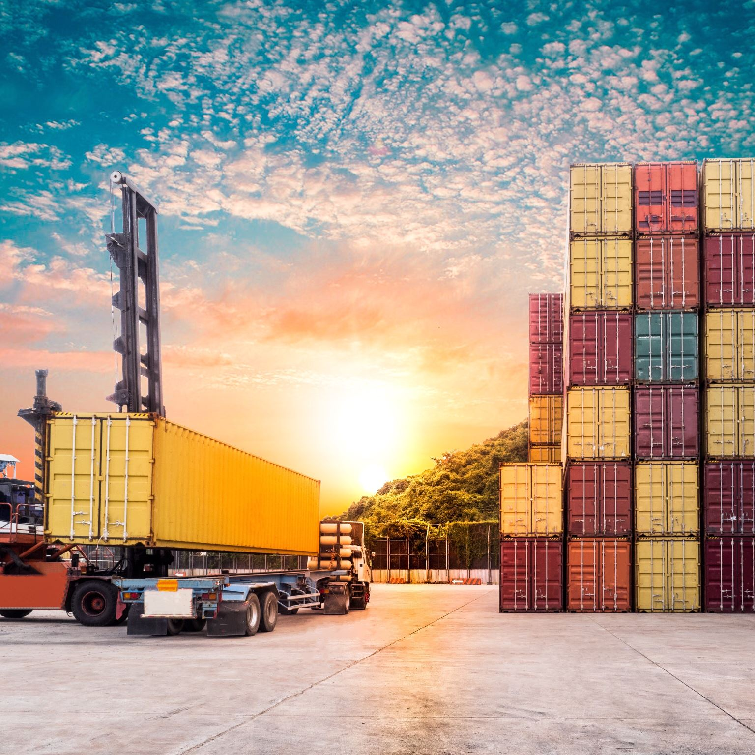
Reverse Logistics and Other Preceding Terms
The effective and efficient management of the series of activities required to retrieve a product from a customer to either dispose of it or recover value
Reverse logistics can be considered as part of green supply chain management (GSCM), the latter being part of sustainable supply chain management (SSCM) reverse logistics is the management of the reverse flows of SCs.
Reverse flows management consists of returning the used product or material to the manufacturing organization, which then reprocesses or disposes it in the most efficient and effective manner

Slide 8
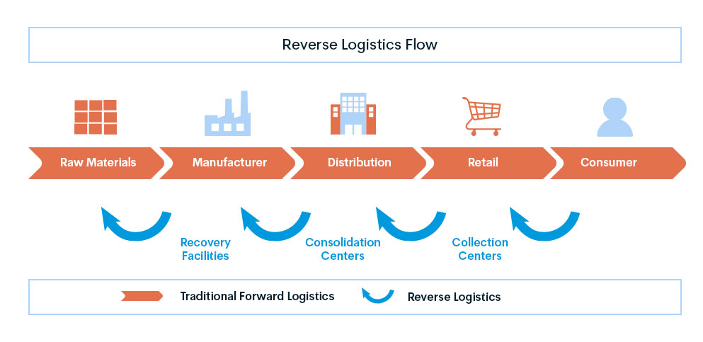

Slide 9
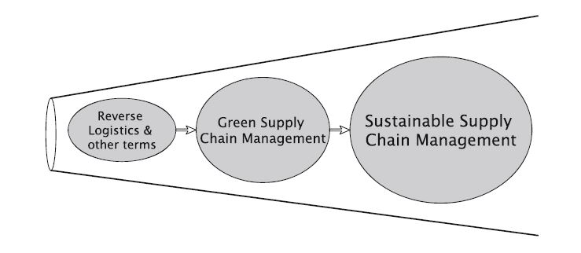
Reverse Logistics and Other Preceding Terms
In order to manage the reverse flows of an organization, there is a need to capture the goods/materials/services from customers and it requires an investment
In some sectors, reverse logistics is required and regulated by governments
In practice, reverse logistics should help reduce inventory costs transportation, and waste disposal costs and should encourage customer loyalty

Slide 10
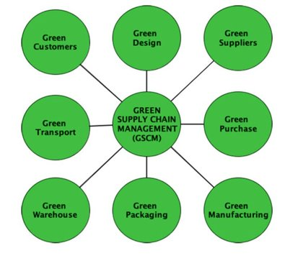
Green Supply Chain Management
GSCM refers to all initiatives taken to reduce, manage, and control the environmental impacts of business activities all along the supply chain
Integrating environmental management requires a process of internal green supply chain management, supplier green supply chain integration, customer green supply chain integration, and community green supply chain integration
The International Standard Organization (ISO) and international guidelines like the Global Reporting Initiative (GRI) or the United Nations Global Compact (UNGC) are sources of information where environment-friendly practices are defined

Slide 11
Organization requires the company to revise its activities of design, purchasing, manufacturing, packaging, warehousing, and transport. In order to make a product or service “green” (i.e., environment- friendly), managers have to interact with engineers at this phase of the product development
Supplier selection can be based on environmental criteria that companies have to determine in accordance with their policies, strategic goals, and regulatory standards. Companies can either impose some environmental criteria to be respected by their suppliers or select suppliers based on environmental criteria and monitor their environmental performance
Customers need to be involved in the process of greening the SC to manage the impact of the product/service in the use and End of Life. This involvement can take the form of voluntary information sharing on environmental management of products and services to make customers improve their practices
Collaboration and coordination with stakeholders as a whole (i.e., not only suppliers and customers but also government bodies, NGOs, or local communities) is needed to improve the green performance of supply chains
Internal Green Supply Chain Management
Supplier Green Supply Chain Intergration
Customer Green Supply Chain Integration
Community Green Supply Chain Integration

Slide 12

Sustainable Supply Chain Management
The management of material, information and capital flows as well as cooperation among companies along the supply chain while taking goals from all three dimensions of sustainable development, i.e., economic, environmental and social, into account which are derived from customer and stakeholder requirements
To manage supply chains sustainably, it is important to integrate sustainability at different strategic levels of SCs through
(1) governance mechanisms and top management,
(2) at the operational level,
(3) at the product/service level
(4) through supply chain partners

Slide 13

Integrating Sustainability in Supply Chain Governance Mechanisms and Top Management
Governance mechanisms for SSCM exist among supply chain partners through the board of directors and the top management, through partnerships between two or more companies, and through representative organizations like federations
Governance is to be understood as “the way organizations are managed at the highest level, and the systems for doing this
To manage a SC sustainably, it is essential that sustainability is considered as a value at the highest level of organizations and that it forms part of the mission and vision of each organization
it is needed to involve the board of directors, shareholders, and the top management by raising awareness, developing sustainability policies, using tools such as charts and codes of conduct, and training people.

Slide 14

Integrating Sustainability at the Operational Level
Integrating sustainability into all departments of the company such as Finance, Information Technology, Accounting, or Marketing. Indeed, to make a SC sustainable
It is particularly needed to involve all departments that play a role in the planning of activities, the sourcing, the procurement, the internal and external logistic activities, and the manufacturing/use and post-use phases of the product life cycle
Such an integration requires a strong information system to manage all the information, financial, and product flows along the SC that include both environmental and social criteria according to the SC sustainability targets
For this purpose, some key functions in the SC like the procurement function are supported by norms. ISO 20400 is one of these norms guiding toward sustainable procurement practices

Slide 15

Integrating Sustainability at the Product Level
Sustainability should be part of the design of the product/service to limit or eliminate its negative environmental and social impacts during its production, use, and end-of-life phase.
To ensure this, the environmental life cycle assessment (E-LCA) and social life cycle assessment (S-LCA) tools can be used An LCA looks at the impact “that a product has on people who interact with the life cycle of the product
LCA looks at these impacts during the phase of resources and material use, components and semi-products, manufacture, use and maintenance, and recycling and disposal

Slide 16

Transferring Sustainability to Supply Chain Partners and Monitoring Sustainability
Transferring sustainability to SC partners means here developing suppliers’ skills and competences so that they can reach the same sustainability performance as the initiating company, which usually is the focal company. Monitoring means here to develop ways to assess this sustainability performance over time and measure the progress made.
Collaboration with suppliers consists in assisting suppliers, sharing knowledge with suppliers, providing assistance to suppliers, and integrating resources with suppliers like design,sourcing, and production
To monitor the sustainability performance along the SC, audits can be implemented,either led by the focal company at the different facilities and suppliers’ sites

Slide 17
